Slide 1

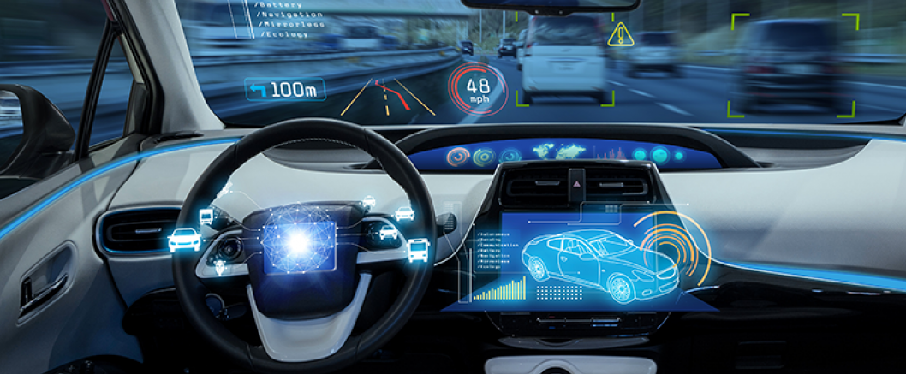
Prediction of inter-vehicle distance in an autonomous vehicle using the CNN and RNN to improve the modal sensing
Group 5

Slide 2

Agenda
Introduction to Autonomous vehicles
Why the need for the project?
Previous work done on this topic
Source of dataset and EDA
Tools/skills required
Project Update
Foreseen challenges in the project
Proposed project outcome

Slide 3
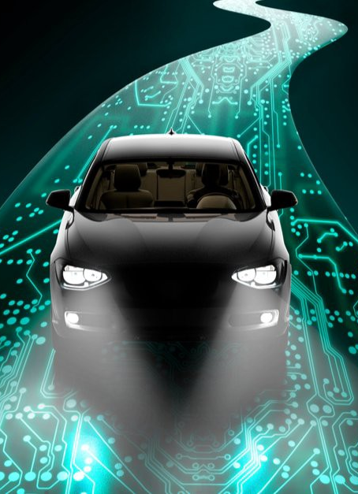
Introduction to Autonomous Vehicles
Autonomous cars, also known as self-driving cars, are vehicles that can operate without direct human input. These cars use a combination of sensors, cameras, radar, and other technologies to detect their surroundings and make decisions based on that information.
Autonomous cars can be categorized into different levels of autonomy based on the extent of human input required. The six levels of autonomy are:
Level 0: No automation - The driver has full control of the vehicle at all times.
Level 1: Driver assistance - The car can assist the driver with either steering or accelerating/decelerating, but not at the same time.
Level 2: Partial automation - The car can assist the driver with both steering and accelerating/decelerating simultaneously, but the driver must remain engaged and ready to take control at any time.
Level 3: Conditional automation - The car can operate without driver input under certain conditions, but the driver must be ready to take control when requested by the car.
Level 4: High automation - The car can operate without driver input under most conditions, but the driver may need to take control in certain situations.
Level 5: Full automation - The car can operate without driver input under all conditions and can perform all driving tasks.

Slide 4
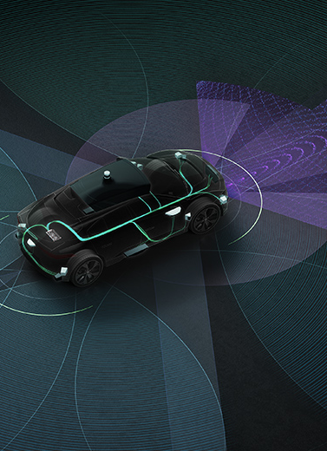
Benefits of Autonomous Vehicles
Improved safety: The advanced sensors and algorithms used in autonomous vehicles can detect and respond to potential hazards more quickly and accurately than humans.
Increased mobility: provide transportation to people who are unable to drive, such as the elderly or people with disabilities, allowing them to be more independent and mobile.
Reduced traffic congestion: Autonomous vehicles can potentially reduce traffic congestion by optimizing traffic flow and minimizing the need for human drivers to make sudden or inefficient maneuvers.
Increased efficiency: Autonomous vehicles can be more fuel-efficient and reduce the amount of greenhouse gas emissions produced by vehicles, as they can be programmed to drive more efficiently and reduce idling time.

Slide 5
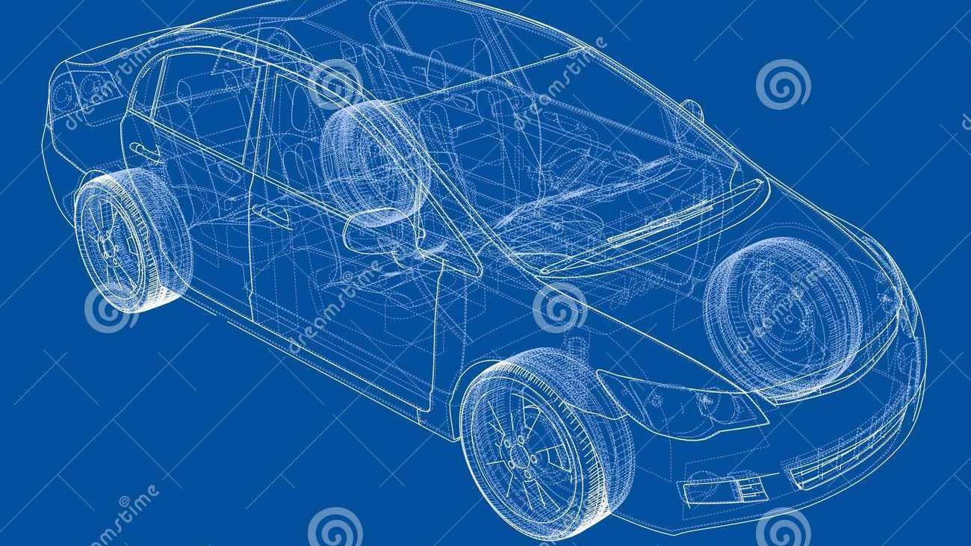
Benefits of Autonomous Vehicles– contd’
Improved productivity: Autonomous vehicles can free up time for drivers to work, relax, or engage in other activities during their commute, which can increase productivity.
Cost savings: Autonomous vehicles can potentially reduce the cost of transportation by eliminating the need for drivers, reducing fuel consumption, and improving the efficiency of transportation networks.
However, it is important to continue developing and testing the technology to ensure that it is safe, reliable, and effective.

Slide 6
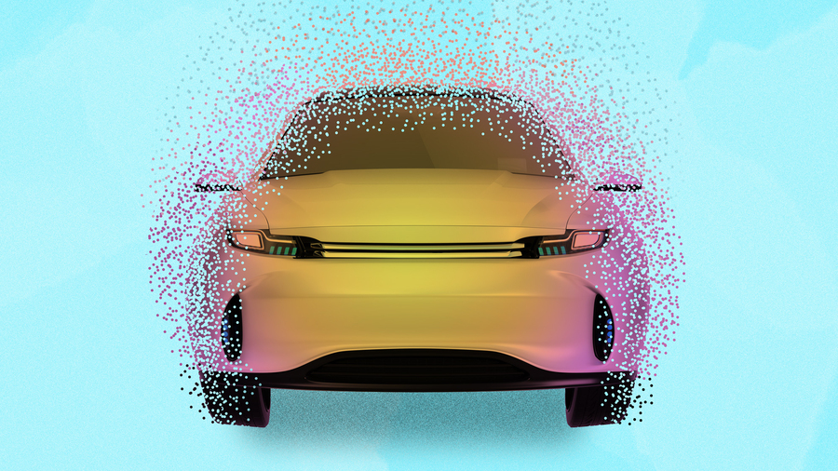
Problem statement
The inter-vehicle distance between autonomous cars is an essential parameter for ensuring safe and efficient autonomous driving.
The current systems for determining inter-vehicle distance rely on sensors and communication between vehicles, but there are still challenges in accurately measuring and maintaining safe distances between vehicles.
We will improve the accuracy and reliability of inter-vehicle distance measurements, especially in situations where communication between vehicles may be disrupted or unavailable.

Slide 7

Project Objectives
To keep the inter-vehicle distance within a more appropriate range, road traffic efficiency will first be considered.
To provide users with more options, our second goal is to characterize driving behaviors more thoroughly.
Finally, to make the suggested model more acceptable and useful, we intend to create the driver model in conjunction with the lower controller's executive capability.
The multiple objectives include minimizing the following:
the error between actual inter-vehicle distance and desired inter-vehicle distance to reflect driving styles.
the relative speed to the leading vehicle to maintain the following behavior.
the acceleration and the jerk to ensure comfort. In addition, constraints can be integrated into the driving style while ensuring safety.

Slide 8
Past Research work
LiDAR and RADAR detect the conditions outside the vehicle and feed that data to the central processor. These sensors provide short-distance information and are often leveraged to aid parking and backup systems.
Abdelmoghit et al proposed an algorithm based on stereo vision for distance measurement using only web cameras, and the calculation formula contains simple terms based on web cameras criteria obtained by manual measurement
In this method they;
capture the images from the scene using both cameras.
Vehicle detection algorithm is applied to only one image.
stereo matching algorithm is applied to detect and match the same vehicles in the other image.
Finally, the horizontal centroids of vehicles in both images are used to measure the inter-vehicles distances

Slide 9
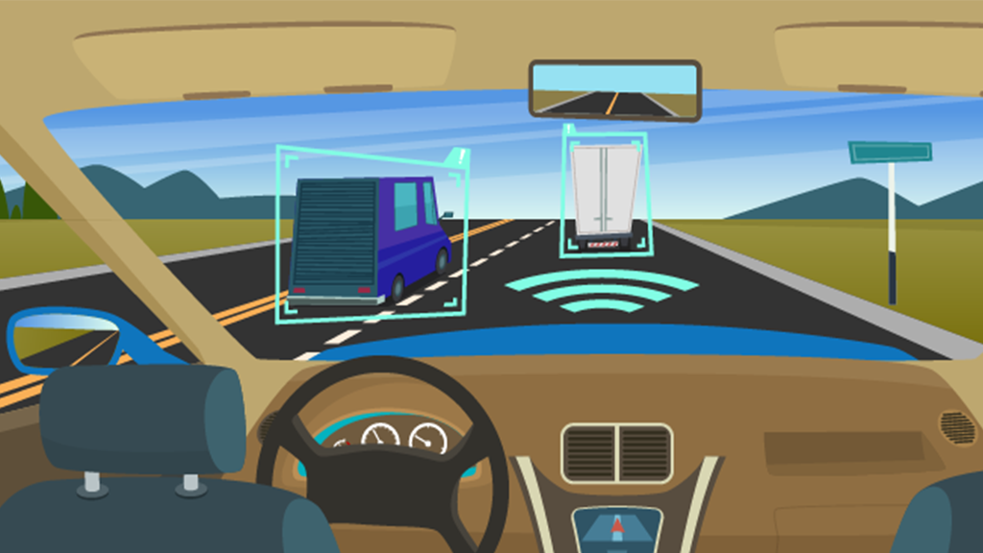
Skill required for project work
1. Python: Numpy, Pandas, Scikit learn, Tensor flow, Matplotlib, Streamlit, and Seaborn
2. Neural Networks: CNN , KNN and RNN
3. Data Cleaning/Smoothing
4. Data Visualization: Tableau and Dashboard for visualization
5. Microsoft Azure
6. Modal sensing

Slide 10





Our Assumption based on Autonomous following Car
The subject vehicle and the lead vehicle's bumper-to-bumper separation shouldn't be any closer than a safe distance.
Gentle Braking when conditions are normal. When conditions are crucial, deceleration surpasses what is comfortable, and once the threat has been removed, comfortable braking is used.
It should be easy to switch between driving modes, such as from acceleration to car-following mode.

Slide 11
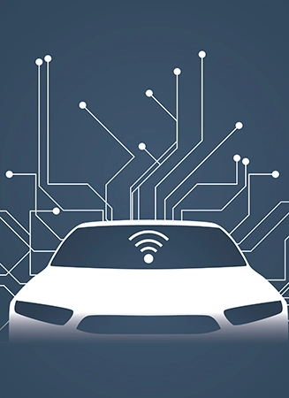
Dataset Source
Researchers for the Next Generation Simulation (NGSIM) program collected detailed vehicle trajectory data on the above-specified freeway segments of US-101 and I-80 as well as the specified arterial segments of Lankershim Boulevard and Peachtree Street. Data were collected through a network of synchronized digital video cameras. NGVIDEO, a customized software application developed for the NGSIM program, transcribed the vehicle trajectory data from the videos.
Link:
https://github.com/Shuoxuan/NGSIM_Cleaned_Dataset

Slide 12
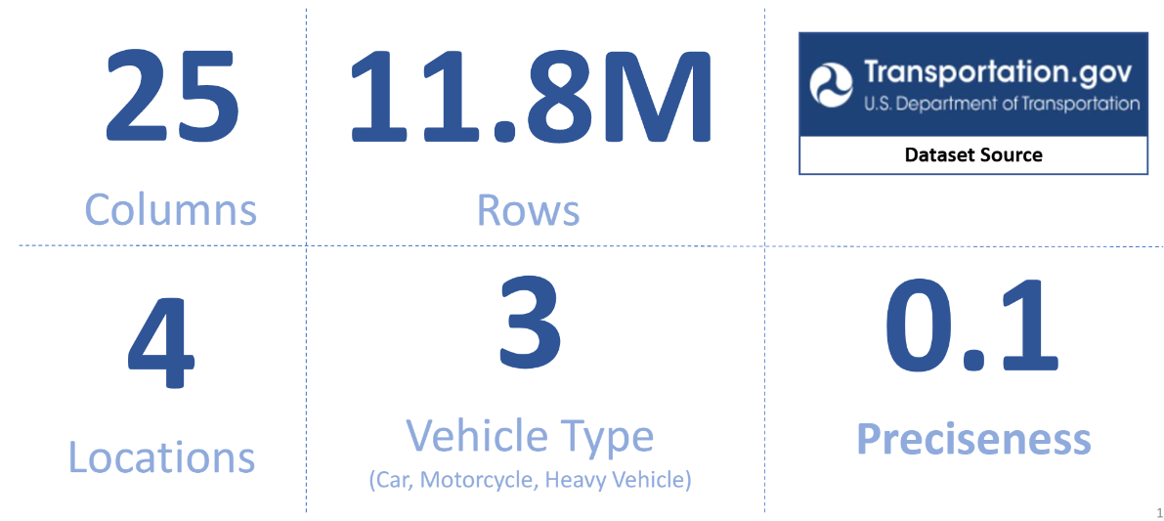
Exploratory Data Analysis
a. The dataset used in this project is called Next Generation Simulation (NGSIM) and it is publicly available on the U.S. Department of Transportation website.
b. The NGSIM dataset consists of 25 columns and 11.8 million rows of vehicle trajectory data which was captured using a network of synchronized digital video cameras on 4 different locations (US 101, I-80, Peachtree, and Lankershim).
c. The data contains the location of a vehicle at every one-tenth of a second, which gives the exact position of each vehicle relative to other vehicles.

Slide 13
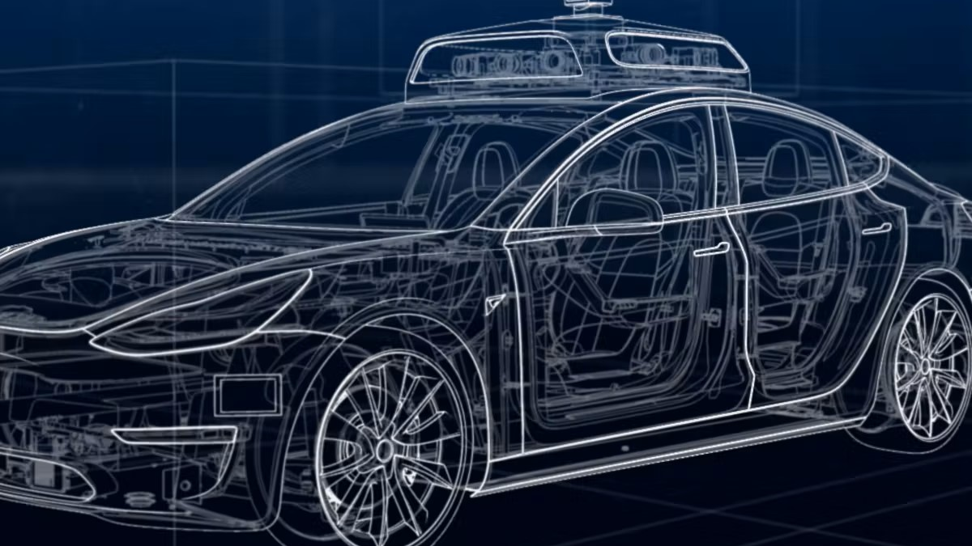
Current update
Data cleaning
Remove duplicates and missing values and set the value for distance
Data partitioning
Prepare for upcoming analysis, make some adjustments to the datasets, and cleaning
Trying to divide the data based on Geography .

Slide 14
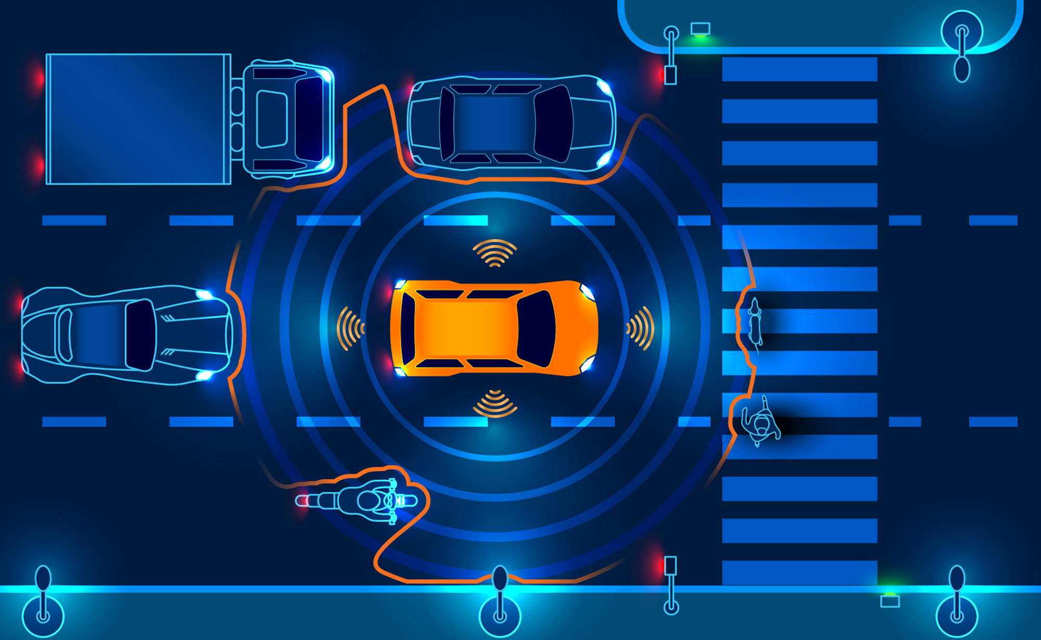
Foreseen Challenges with project
Detecting surroundings vehicles information accurately (e.g. distance between vehicles) in real time is very important.
Algorithm to calculate the inter-vehicle distance
Data partitioning

